Slide 1
Buy Smart
Group Members:
1.Mukesh Singh
2.Raj Surve
3.Radheshyam Yadav
Guide: Prof. Sukhada Aloni

Slide 2
Abstract
In this large growing ecommerce industry there are so many products with different brand’s price range are available in ecommerce store such as Amazon, Flipkart, Snapdeal, Paytm Mall, etc. where product price range varies with same product, there are different prices on different ecommerce websites there may be some seasonal offers on the product or on that store due to which price may vary. In this busy digitial environment searching about same product in different ecommerce websites may be time consuming for consumers to ease that effectively and efficiently we are creating a Product Comparison System named as Buy Smart which will compare product price from different ecommerce websites with their offers and current availability

Slide 3
introduction
Buy Smart is a production comparison system to compare prices of products in different websites at same time based on its availability at the user’s location .
It will display the exact amount by taking data from different websites in which products are available.
The system is based on massive data manipulation and content based analysis technique to analyze the price in different websites.

Slide 4
Objective
The primary objective is to build a system to compare product prices and accordingly show their availability with a respective portal’s buy link.
To provide a platform to different users to buy products online .
To use a single website to view same product price and details from different websites at a same time .

Slide 5
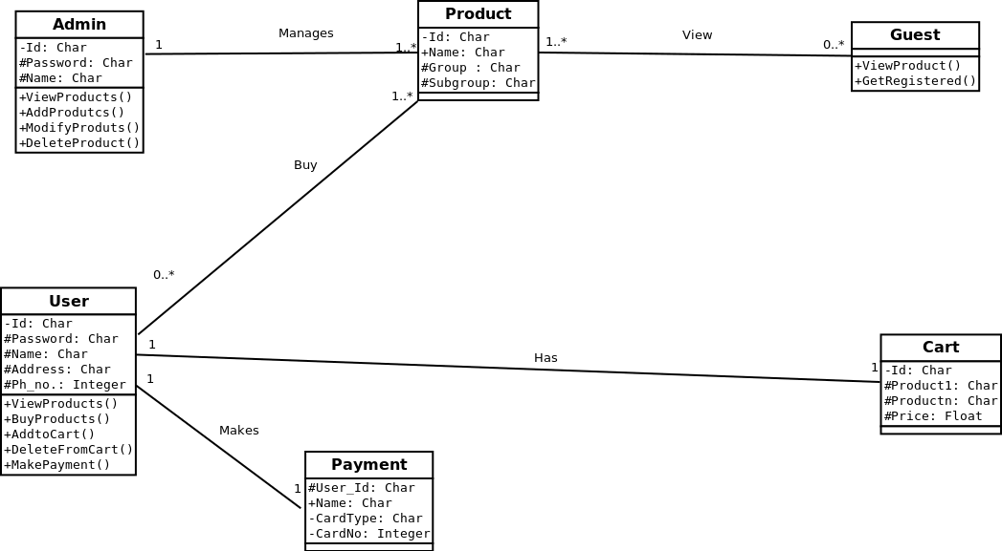
UML:CLASS DIAGRAM

Slide 6
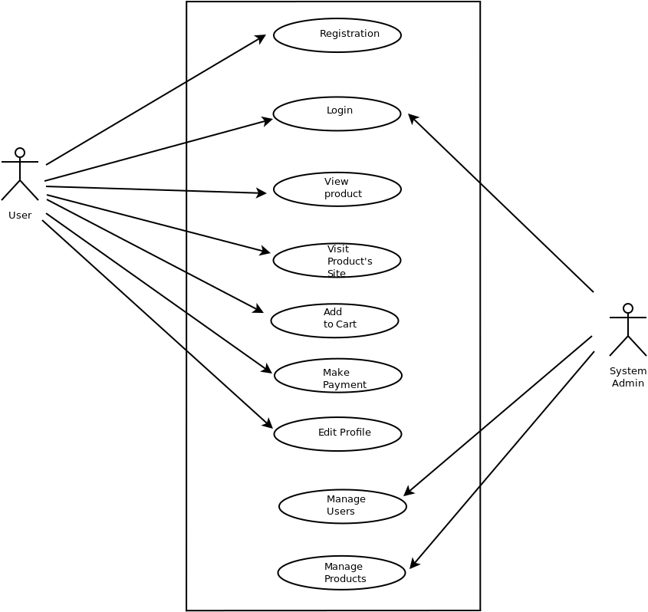
UML:uSE CASE DIAGRAM

Slide 7
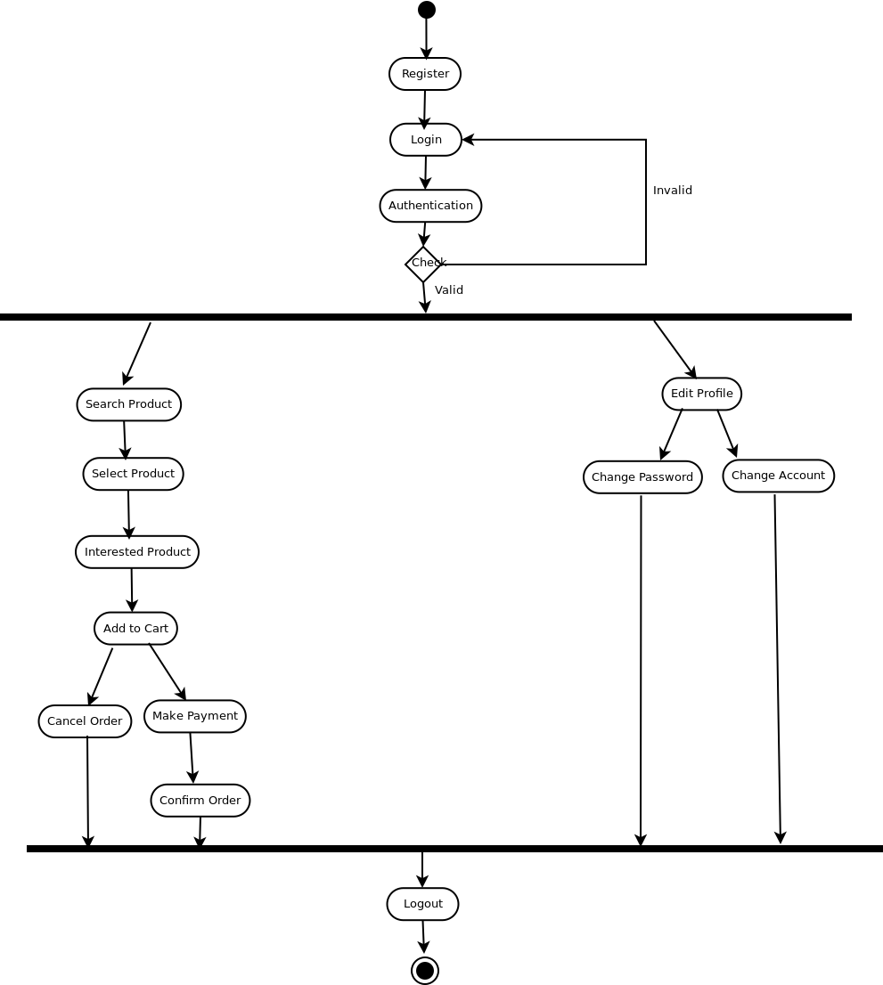
UML:aCTIVITY DIAGRAM

Slide 8
Literature review
A Price Comparison System Based on Lucene : DOI 10.1109/ICCSE.2013.6553894 : This paper presents a product price comparison oriented product search engine, inorder to show all possible prices of products for customers.
Comparison-Shopping Services and Agent Designs : In this book we studied about actual working of different shopping portals and difference in their overall models and working

Slide 9
Future Scope
We can add local vendors and compare prices with other shopping sites.
Users can add different products from different portals at a single cart and can make transaction of those added products at a same time.

Slide 10
Technology stack
PHP
jQuerry
MySql
JavaScript

Slide 11
Benefits for society
Instead of browsing multiple shopping sites user can access them by using one webportal .
It will save user’s time and data .

Slide 12
Conclusion
By making a single platform available for users to compare and buy products from multiple shopping portals will make their shopping experience much more easier .

Slide 13
Thank You

